Slide 1
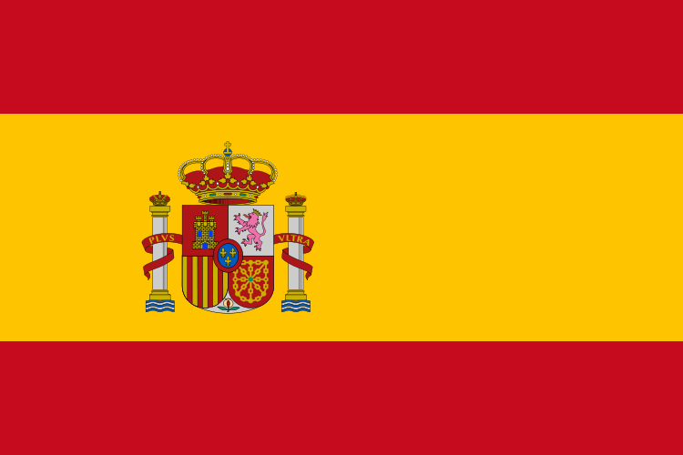
SPAIN
Martha
& Athena

Slide 2
Widely known for Flamenco music and dance, bull-fights, fantastic beaches and a lot of sunshine, Spain has to offer much more than that.
It is - and has been for thousands of years - one of the cultural centers of Europe. It has beautiful cities and towns, offering really old monuments as well as futuristic architecture.
Its various regions are all different one to each other, geographically, climatically and even in personality. It is a fascinating country

Slide 3
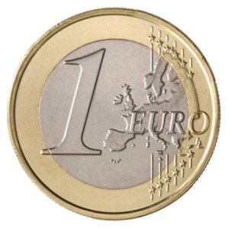
Information
Spain is in southwestern Europe on the Iberian Peninsula. The capital is Madrid. In Spain live 45,8 millions people. They use the euro.

Slide 4
Language
Spain is openly multilingual, and the constitution establishes that the nation will protect "all Spaniards and the peoples of Spain in the exercise of human rights, their cultures and traditions, languages and institutions.
The other official languages of Spain, co-official with Spanish are:
Basque in the Basque Country and Navarre
Catalan in Catalonia, the Balearic Islands and in the Valencian Community, where its distinct modality of the language is officially known as Valencian
Galician in Galicia

Slide 5
Religion
Roman Catholicism has long been the main religion of Spain, and although it no longer has official status by law, in all public schools in Spain students have to choose either religion or ethics and Catholic is the only religion officially taught. According to a July 2009 study by the Spanish Center of Sociological Research about 73% of Spaniards self-identify as Catholics, 2.1% other faith, and about 22% identify with no religion among which 7.3% are atheists.

Slide 6
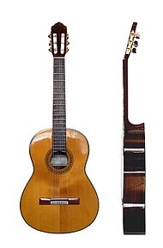
Music
The music of Spain has a long history and has played an important part in the development of western music. It has had a particularly strong influence upon Latin American music. The music of Spain is often associated abroad with traditions like flamenco and the classical guitar but Spanish music is, in fact, diverse from region to region. Flamenco, for example, is an Andalusian musical genre from
the south of the country

Slide 7
flamenco
flamenco is a genre of music, song and dance from Andalusia in southern Spain, noted for its energetic, staccato style. It grew from Andalusian music, song and dance styles, influenced by the song and dance of the local Romani people.

Slide 8
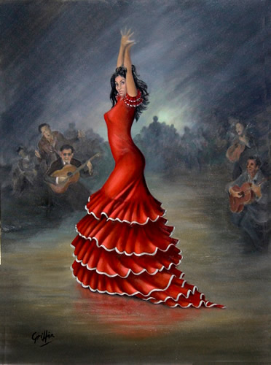

Slide 9
Monuments
Plaza Mayor
This is one of the most stunning arcaded
squares in all Spain. The Plaza Mayor was
constructed from 1729 to 1755 in the
Baroque style by the architect Alberto
Churriguera

Slide 10
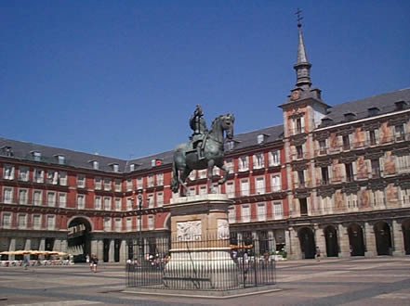

Slide 11
Royal palaces
The Palacio Real de Madrid is the official home of the King of Spain. It is located in Madrid, Spain. It is one of the largest palaces in western Europe. The Almudena Cathedral is nearby the palace. The Royal Palace is still used for special ceremonies.

Slide 12
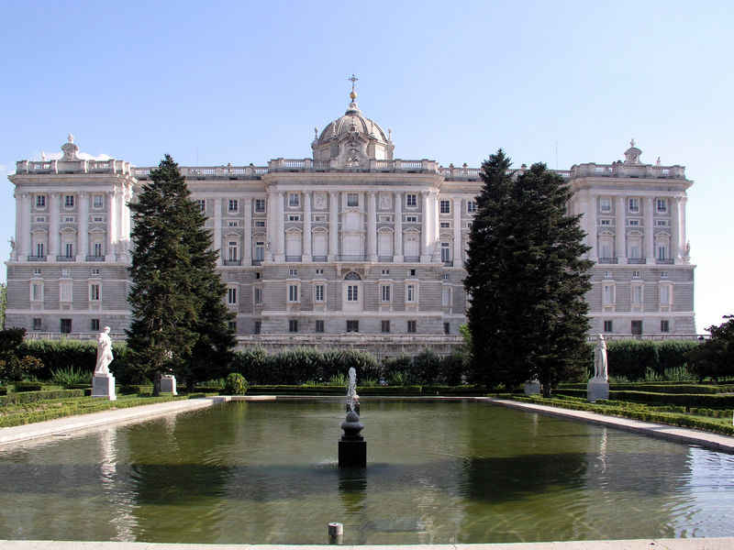

Slide 13
Botanical garden
The Real Jardín Botánico de Madrid is an 8-hectare (20-acre) botanical garden located at Plaza de Murillo, next to the Prado Museum in Madrid.
The garden was founded on October 17, 1755, by King Ferdinand VI, and installed in the Orchard of Migas Calientes, near what today is called Puerta de Hierro, on the banks of the Manzanares River. It contained more than 2,000 plants collected by José Quer y Martínez, botanist and surgeon.

Slide 14
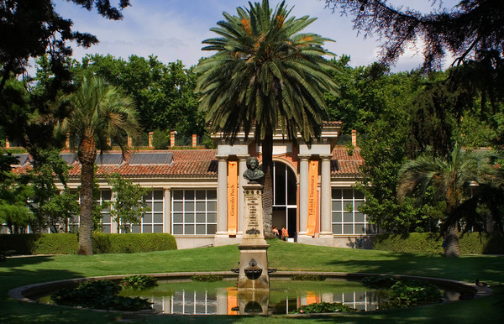

Slide 15
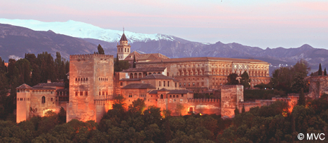
The Arab palace of Grenada
Granada was first settled by native tribes in the prehistoric period, and was known as Ilbyr.

Slide 16
Museum Prado
The Museo del Prado is the main Spanish national art museum, located in central Madrid. It features one of the world's finest collections of European art, from the 12th century to the early 19th century, based on the former Spanish Royal Collection, and unquestionably the best single collection of Spanish art.

Slide 17
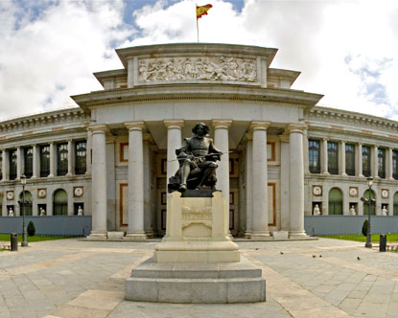

Slide 18
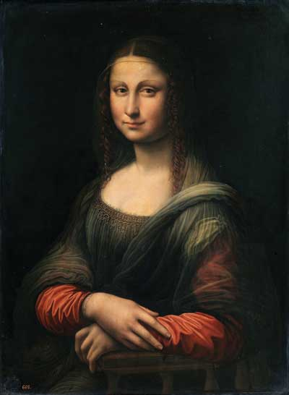
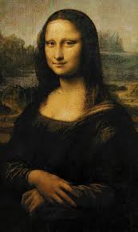

Slide 19
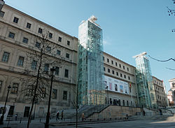
REYNA SOFIA
The building has been functioning as the Centro del Arte (Art Center) since 1986 but was established as the Museo National Centro de Arte Reina Sofia in 1988.

Slide 20
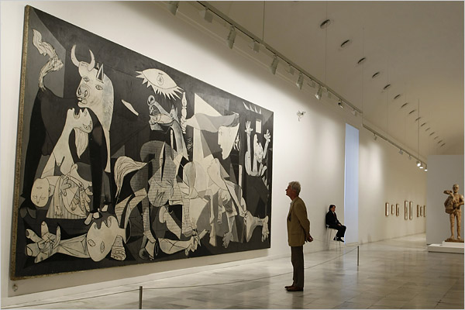

Slide 21
The end!!
Music:
http://www.youtube.com/watch?v=jcO7icvP4_s

